Slide 1
Customer Meeting

Slide 2
Our progress
Fall into a routine with customer interaction. Establish communication channels

Slide 3
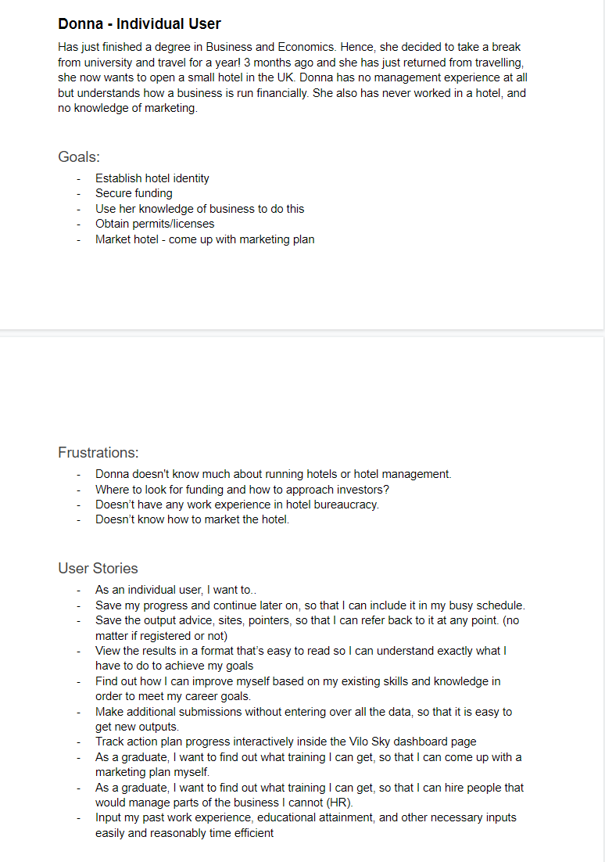
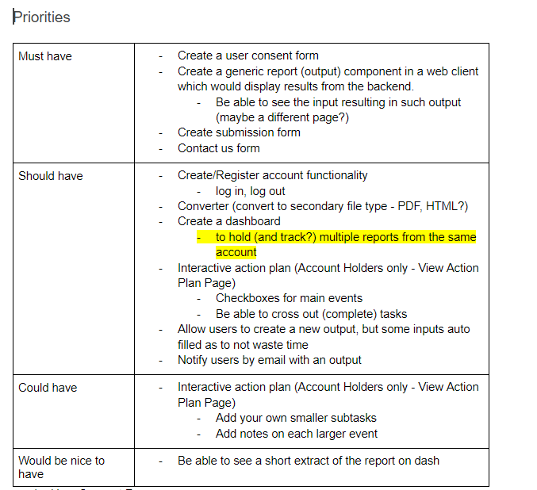
Our progress
Fall into a routine with customer interaction. Establish communication channels
Evaluate product requirements from various user perspectives, create user stories and tasks and prioritise these tasks

Slide 4
Our progress
Fall into a routine with customer interaction. Establish communication channels
Evaluate product requirements from various user perspectives, create user stories and tasks and prioritise these tasks

Slide 5
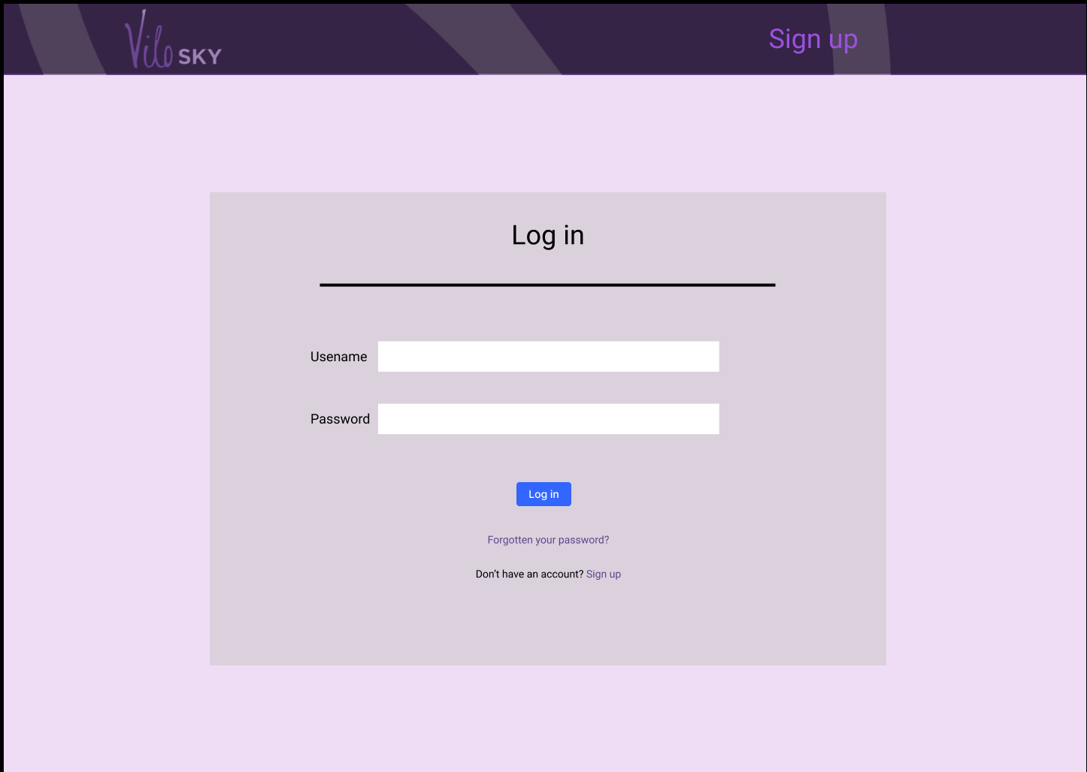
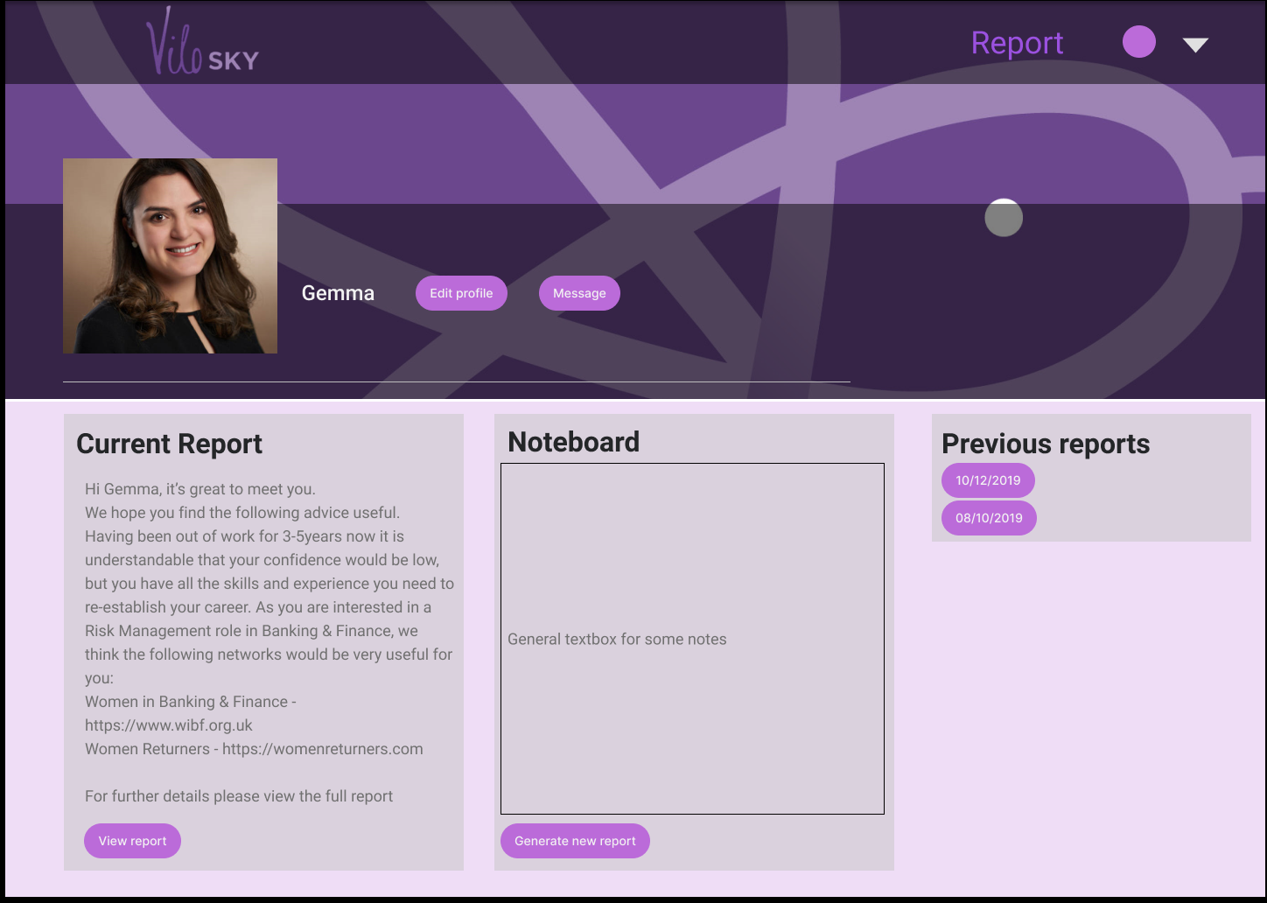
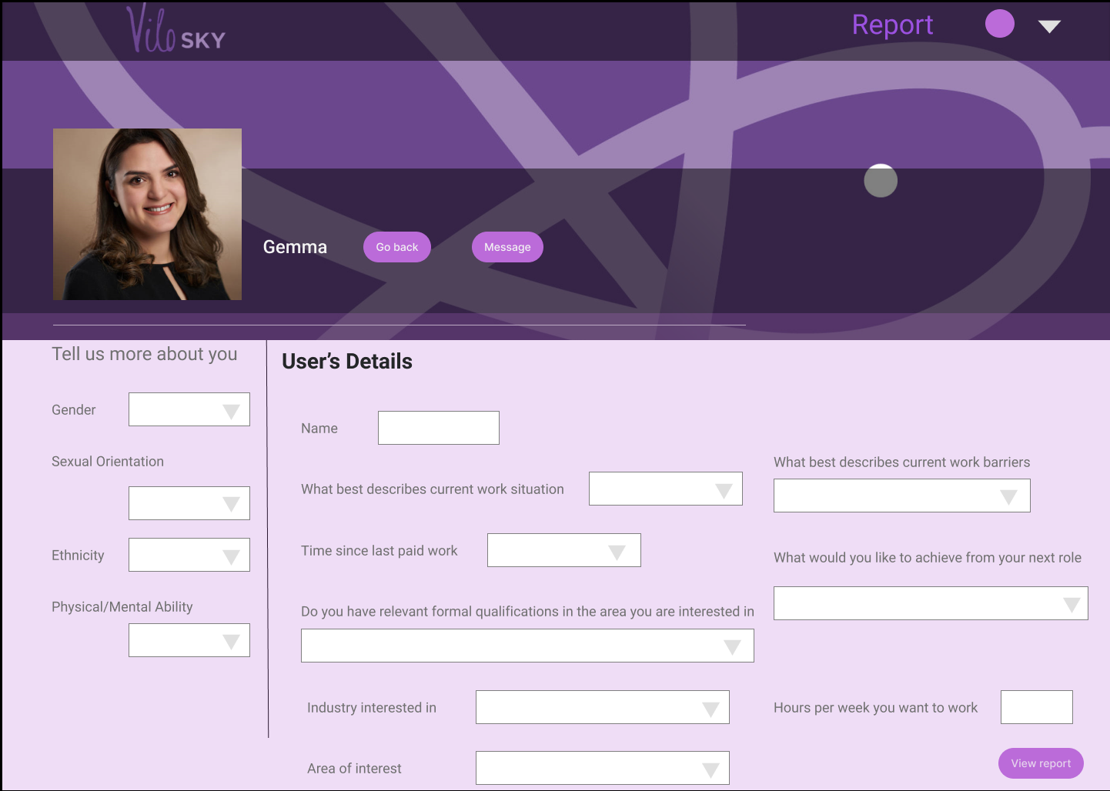
Our progress
Fall into a routine with customer interaction. Establish communication channels
Evaluate product requirements from various user perspectives, create user stories and tasks and prioritise these tasks
From a refined list of requirements generate a set of initial wireframes.

Slide 6


Our progress
Fall into a routine with customer interaction. Establish communication channels
Evaluate product requirements from various user perspectives, create user stories and tasks and prioritise these tasks
From a refined list of requirements generate a set of initial wireframes.
Decide on a technology stack.

Slide 7
Next iteration goals
Sitemap
ER Diagram
Wireframes (proposing different options)
Data flow diagrams
Initialize backend/client projects
Research initial test coverage
IP agreement

Slide 8
Questions
Not saving de-personalized action plans in an HR rep. Is it a good idea?
Is being able to export results as a pdf a top priority during the development?
How important is providing statistics information to the admin?

